Slide 1
Saving the Software Heritage - the process -
Laura Bussi^{1,2}
Roberto Di Cosmo²
Carlo Montangero¹
Guido Scatena¹
¹Department of Computer Science, University of Pisa
²Software Heritage
Notes:
Good morning!
Let me share with you my excitement, since it is the first time I speak in public in the town where I grew up!
I’m going to talk about the process that I and the colleagues listed here are proposing to save our Software Heritage.

Slide 2
Roadmap
Prologue
SWH: The Software Heritage initiative
SWHAP: The SWH Acquisition Process
SWHAPPE: The SWHAP Pisa Enactor
Epilogue
Notes:
Here what we are going to do:
in the prologue we will frame our proposal in the larger picture of Software History
then we quickly describe the Software Heritage initiative, which the context motivating our work
then we describe SWHAP, the SWH Acquisition Process, an abstract view of our approach to software archaeology
to move to SWHAPPE, the SWHAP Pisa Enactor (enact is the word used in the Software Development Process community, where I come from, to designate the actual execution of a development process)
and finally round up with some lesson learnt, open issues and future work.
I’m not going to blame you if you think that we are competing with the DoD in creating acronyms…

Slide 3
Roadmap
Prologue
where we frame our work in the larger picture of software history
SWH: Software Heritage
SWHAP: The SWH Acquisition Process
SWHAPPE: Concrete support to the acquisition
Epilogue
Notes:
To frame our work in the larger picture of software history, let’s start with two fundamental questions, posed by M.S. Mahoney in What Makes the History of Software Hard and Why It Matters. Annals of the History of Computing 30,3 (2008)

Slide 4
Which are the sources?
Ideally [Mahoney, 2008]: running software
"historians of technology must tinker with the things to discover the ideas which […] informed them" and
historians of technology must "experience the software as users experienced it and hence analyze that experience critically".
Actually, for legacy software: source code
Hence, our work
Notes:
The first question is, which are the sources of software history?
According to Mahoney, ideally they should be the running software since
"historians of technology must tinker with the things to discover the ideas which […] informed them" and
"experience the software as users experienced it and hence analyze that experience critically".
This is questionable, but we want discus it now. Unfortunately, it is also too difficult, for legacy software, since most often when we are lucky we are left with the static artifacts, the source code, and often incomplete.
Software Heritage will perhaps change the situation, since it may save the whole tool-chain and so preserve executability (modulo hardware emulators).
So, our work targets the recovery of source code.

Slide 5
Why is software history hard?
"Just as
the design of software
begins with
an analysis of
the activity to be automated...
...the history of software
begins with
the history of what was done to understand how
the practice (of that activity) was translated into a computational model."
[Mahoney, 2008]
Notes:
The second question is: Why is software history hard?
The short answer is "to a large extent because of what makes software engineering hard: it is only accidentally about computers...".
The long one is in the slide, and can depicted as in the next slide

Slide 6
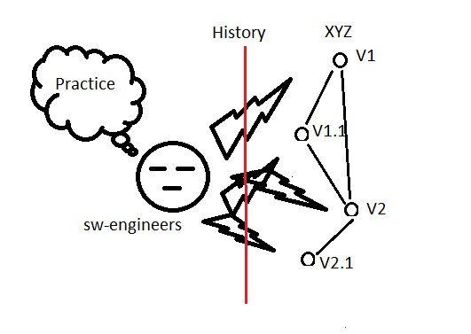
Recover first the version history
Notes:
Recover first the version history, what happened in a single system.
The paramount example here is Diomidis Spinellis’ monumental work on the development of Unix.
What we do is precisely this: SWHAP provides guidelines on how to recover the version history of a software system, and SWHAPPE provides digital support to the process.

Slide 7
Roadmap
Prologue
The Software Heritage initiative
Where we frame our work in its own context
SWHAP: The SWH Acquisition Process
SWHAPPE: Concrete support to the acquisition
Epilogue
Notes:
So, let’s see the context of our work, the Software Heritage Initiative, launched and directed by one of us, Roberto Di Cosmo

Slide 8
Software Heritage
Mission: build an infrastructure to collect, preserve and share the source code of all available software on the long term
Requirements: ensure
Availability
Open architecture, software, and collaboration
Traceability
Unique intrinsic identifiers, directly computed from the source code
Uniformity
access through the same uniform API/web interface
Notes:
Mission of SWH: to build the Universal Archive of Source Code, that is an infrastructure to collect, preserve and share on the long term as much source code as possible - cfr. the 2018 paper in the CACM.
The goal is indeed to collect all the software, but this is questionable… Not the point of this presentation.
Requirements
availability : the code will be stored, preserved and made accessible on the long term:
SWH points on Open architecture, software, and collaboration provide a solid foundation.
Distributed, multipeer infrastructure
traceability : each software component will get a unique identifier that can be relied upon in the long term, directly computed from the source code
uniformity : despite the great variety of origins, all of the source code collected in our archive will be accessed through the same uniform API/web interface

Slide 9
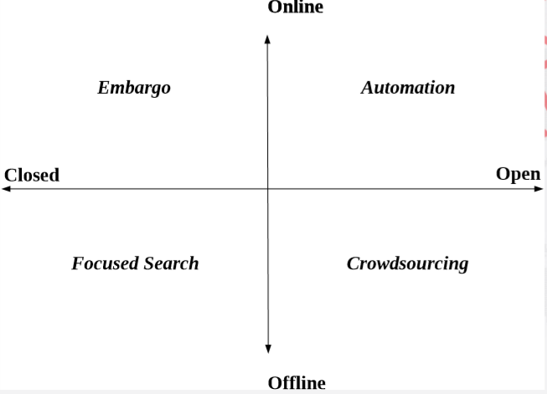
Dimensions of source recovery
Notes:
How do you go at collecting source code? Here are some possibilities:
Left part: off limits, for now.
Up-right quadrant: SWH up to now, it sends out spiders and ingests whatever it finds (bots?)
Low-right quadrant: SWHAP
In which sense, embargo? Who is putting it in place?

Slide 10
Software Heritage, as of Oct. 2019
Harvested code
90,860,137 projects
6,317,723,261 source files
1,394,141,708 commits
Infrastructure
Main code repository at INRIA in Paris
Mirror in ENEA in Bologna – announced on Oct. 24
Partnership with UNESCO
Sponsored by Intel, Microsoft, Google, GitHub, ...
Notes:
Commits are the historic elements

Slide 11
Roadmap
Prologue
The context: Software Heritage
SWHAP: The SWH Acquisition Process
Where we sketch our proposal for software archaeology
SWHAPPE: Concrete support to the acquisition
Epilogue
Notes:
Our work, an abstract perspective, replicable in different working environments

Slide 12
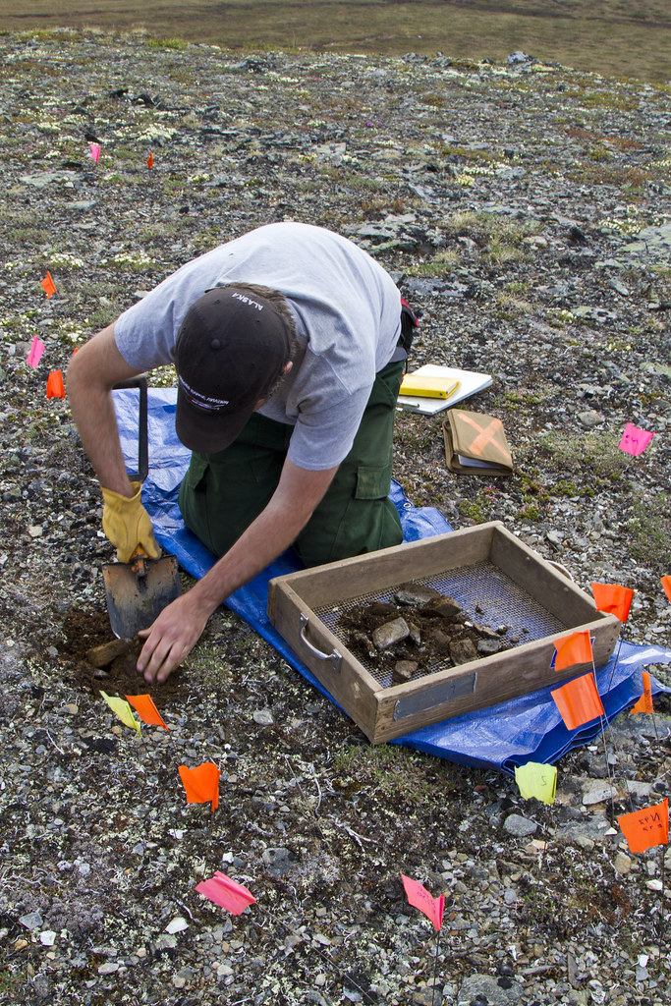
A naïf view of archeologists' work
First, on site, they collect and identify the finds.
Then, in the museum, they safely store, curate, and exhibit them.
Often, they come back on site for a new campaign.
Notes:
Obviously, reality is much more complex and intertwined, but we hope to cope with it…

Slide 13
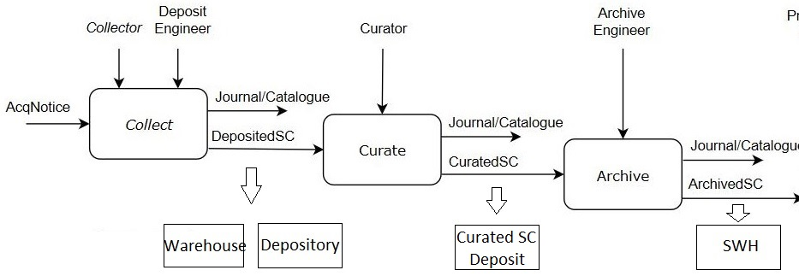
SWHAP: an overview
Notes:
Collect: The purpose of this phase is
to find the source code and related materials and
to gather it as is in a physical and/or logical place where it can be properly archived for later processing.
(Wherehouse and Depository)
Curate: The purpose of this phase is
to analyze, cleanup and structure the raw material that has been collected. (Curated SC Deposit)
Archive: The purpose of this phase is
to contribute the curated source code to Software Heritage (SWH)
The other materials have to be archived into the infrastructures specialized for each kind of materials: Wikimedia for images or videos, open access repositories for research articles, Wikidata for software descriptions and properties, and so on.
But this is future work, related to the fourth phase (present, or better exhibit – not shown): The purpose of this phase is to create dedicated digital exhibits of the curated materials, that may complete the physical exhibit in the museum.

Slide 14
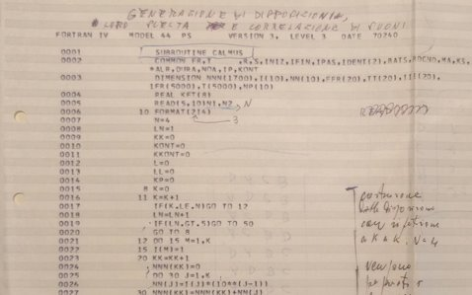
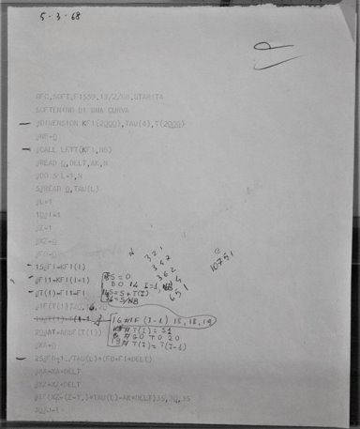
The deposited harvest, so far
Softi, a small numerical exercise, CEP Fortran (1968)
TAUmus, TAU2 controller, IBM Fortran (70's)
CCM, customizable memory manager, C++ (1994)
OrbFit, astronomy library, FORTRAN (current)
Notes:
Softi: Code developed for the CEP by Tonina Starita in 1968, to smooth a curve.
About a hundred lines of offline code , also assembly and command language, four versions
TAUmus: Code controlling TAU2, a music synthesizer of the '70s.
About a couple of hundred lines, offline, two versions, plus a lot of ancillary materials
CMM: Customisable Memory Manager, used in Java.
A few thousands of lines, online, several local contributors (CS, Unipi), nine releases with a hole, in-house VCS
OrbFit: an astronomy library to compute orbits and ephemerides
Many thousands lines, online, many distributed contributors (Math, Unipi et al, not only in Italy), GitHub
A dozen more still to be curated, put forward in response to a call-to-contribute by the Rector of the University, ranging
from the I/O routines in decimal machine language, manually assembed for the CEP (1964)
to UBORA, an infrastructure for the development and sharing of open source medical devices (current).

Slide 15
Roadmap
Prologue
The context: Software Heritage
SWHAP: The SWH Acquisition Process
SWHAPPE: Concrete support to the acquisition
Where we talk about the SWHAP Pisa Enactor
Epilogue
Notes:
Our work, a concrete perspective, usable on GitHub.
Focused on the digital part of the process

Slide 16
SWHAPPE: requirements
Long term availability
Historical accuracy
Traceability
Openness
Interoperability
Notes:
Long term availability: The places where the artefact (both raw and curated) are stored must provide sufficient guarantees of availability over the long term. These places may be physical (warehouses), or logical (depositories).
Historical accuracy: Any supporting implementation should support the faithful recording of the authorship of the source code as well as of the reconstruction process, e.g., via a flexible versioning system.
Traceability: It must be possible to trace the origin of each of the artifacts that are collected, curated and deposited. For physical materials, we refer to common practice. For digital artifacts, it is recommended to keep a journal of all the operations that are performed, and to automate them as much as possible, as the collection and curation process may require several iterations.
Openness: Any supporting implementation should be based on open and free tools and standards.
Interoperability: Any supporting implementation should provide support for the cooperation and coordination of the many actors playing the many roles of the acquisition process.

Slide 17
SWHAPPE: design choices
The same tool all over the process
to reduce the learning effort and to streamline the process
Git as the revision control system, to manage the source code history
Git supports traceability and historical accuracy, distinguishing between author and committer
GitHub as the collaborative platform,
to host the virtual stores and working areas
to offer a web interface to access the saved information
GitHub is archived in SWH, hence long term availability is guaranteed
Both Git and GitHub are open
Not the only choice, but very popular and active, and supported by Unipi
Notes:
Git is a revision control system, a tool to manage your source code history.
GitHub is a hosting service for Git repositories.
Git is a powerful tool, and requires some expertise to make the most out of it. However, a large part of the process is scriptable, and this will hide the underlying complexity to the final user, which can then focus on the main issue: curating and preserving the code and its history.
The commit and versioning mechanisms offered by Git, allows separating authors from committers: this way on can record both the story of the original software and the story of its curation.

Slide 18
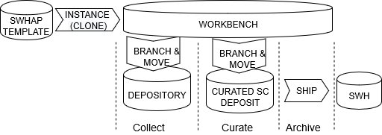
SWHAPPE in practice
Infrastructure at https://github.com/Unipisa/SWHAP-TEMPLATE guide at https://github.com/SoftwareHeritage/swhapguide
Notes:
The template guides the user in creating and managing the repositories, according to the commands in the guide.
orphan branches: one
wants to preserve, in the workbench, what is needed later,
does not want to import spurious historical dependencies in the depository.
This can be done
creating a suitable temporary copy (an orphan branch, technically- see 2)
where the depository is prepared,
copying it in the newly created repository
deleting it thereafter, not to leave around multiple copies

Slide 19
SWHAP-SWHAPPE correspondence
Warehouse: in the MSC in Pisa
most similar to archeology, we need to learn
Virtual areas: repositories
In the ‘Unipisa organization’ space on GitHub.com
For the acquisition of code XXX:
XXX-Depository, to save the original finds
XXX, to save the curated source for SWH
XXX-Workbench, to support the process activities
Notes:
MSC = Museum for Computing Machinery

Slide 20
Some details: recovering the story
For each version of the software ascertain
the main contributing author,
the exact date of the release of this particular version
store these data in a dedicated metadata file
version_history.csv
Notes:
Here you have to divide and number the versions, putting the files of each one in a dedicated folder and determining who did what and when.
In practice, this means that for each version of the software you need to ascertain:
the main contributing author, (the one that will be recorded
the exact date of the release of this particular version
This information should be stored in a dedicated metadata file, version_history.csv

Slide 21
Some details: recording the story
Either manually
Committing the versions in the right order,
Using the info in the .cvs file
Or automatically
Feeding the code and the .csv to
DT2SG: Directory Tree to Synthetic Git
a SWHAPPE tool developed by Guido S.
In either case you get historical accuracy
Notes:
See next slide

Slide 22
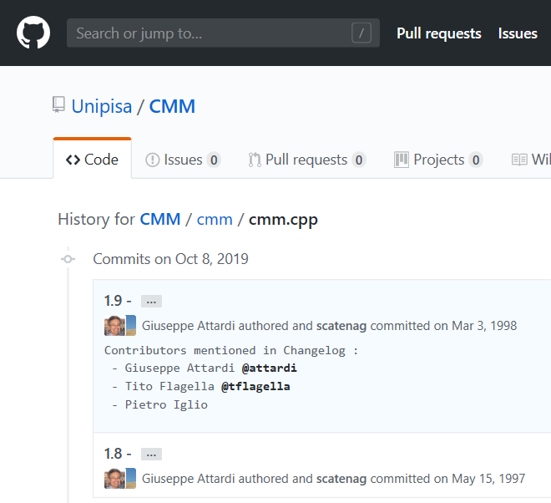
Notes:
Note the two commit dates, and the author/contributor/committer info:
Attardi committed on Mar 3, 1998 (as main author),
scatenag on oct 8, 2019, as curator.

Slide 23
Roadmap
Prologue
The context: Software Heritage
SWHAP: The SWH Acquisition Process
SWHAPPE: Concrete support to the acquisition
Epilogue
Where we draw some conclusions, and look at some open issues for future work
Notes:
Nothing to note

Slide 24
Conclusions
SWH: a cooperative venture to
recover the past to preserve our heritage
share the knowledge to prepare the future
to guarantee scientific reproducibility
to make research software more valuable
to support research on software
SWHAP: guidelines to this end
SWHAPPE: a supporting infrastructure
A new library of Alexandria of source code
Notes:
To guarantee scientific reproducibility:
making easy to make the code available to reproduce the experiment
to make research software more valuable:
making easier to access it
to support research on software
making a very large database available for scientific analysis

Slide 25
Open issues
In the short term:
Increase the level of automation of the SWHAPPE support
In the long term:
Acquire and internalize the procedures to store the physical finds, like listings, etc.
Acquire the means to streamline the transformation into digital form of the same
Critical review of the process
Porting of the process on other platforms
=> we are looking for cooperation and strategies to
create a community
Notes:
Acquire and internalize the procedures to store the physical finds:
Acquire the means to streamline the transformation into digital form of the same: given the great variety of materials, we look for synergy with other institutions
Critical review of the process
Porting of the process on other platforms
=> we are looking for cooperation
and strategies to create a community
I will leave the pointers to our sites.

Slide 26
References
M.S. Mahoney. What Makes the History of Software Hard and Why It Matters. Annals of the History of Computing 30,3 (2008).
D. Spinellis. Unix History Repository. https://github.com/dspinellis/unix-history-repo (2017).
UNESCO. Paris call - Software Source Code as Heritage for Sustainable Development. https://en.unesco.org/foss/paris-call-software-source-code (2018).
Software Heritage. Home page. https://www.softwareheritage.org/ (2019).
J.-F. Abramatic, R. Di Cosmo, S. Zacchiroli. Building the Universal Archive of Source Code. Comm. ACM (Oct. 2018).
Notes:
Comment briefly

Slide 27
Useful pointers
The Software Heritage home page is at
https://www.softwareheritage.org/
The SWHAP guide, call to contribution, and mailing list can be found at
https://www.softwareheritage.org/swhap/
The SWHAPPE home page is at
https://github.com/Unipisa/SWHAPPE
The SWHAP acquisition catalogue is being updated at
https://github.com/Unipisa/SWHAPPE
Notes:
To be left on during the question time

