Slide 1
A Case Study of Legacy Source Code
The Computer Music System TAU2-TAUMUS

Slide 2
TAUmus : why is it so interesting?

Slide 3
TAUmus : why is it so interesting?
Developed in Pisa: fits well the SWHAP@Pisa project

Slide 4
TAUmus : why is it so interesting?
Developed in Pisa: fits well the SWHAP@Pisa project
Dedicated (and still existing) hardware

Slide 5
TAUmus : why is it so interesting?
Developed in Pisa: fits well the SWHAP@Pisa project
Dedicated (and still existing) hardware
A pioneeristic work

Slide 6
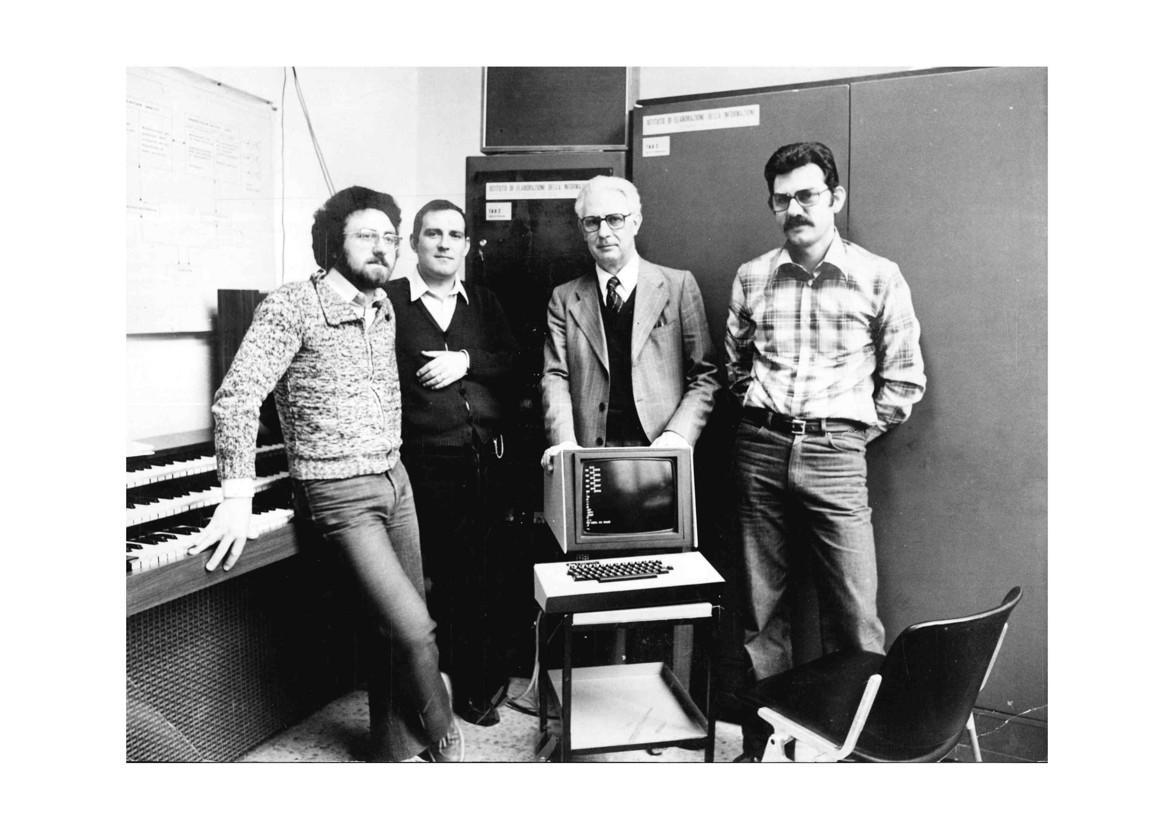
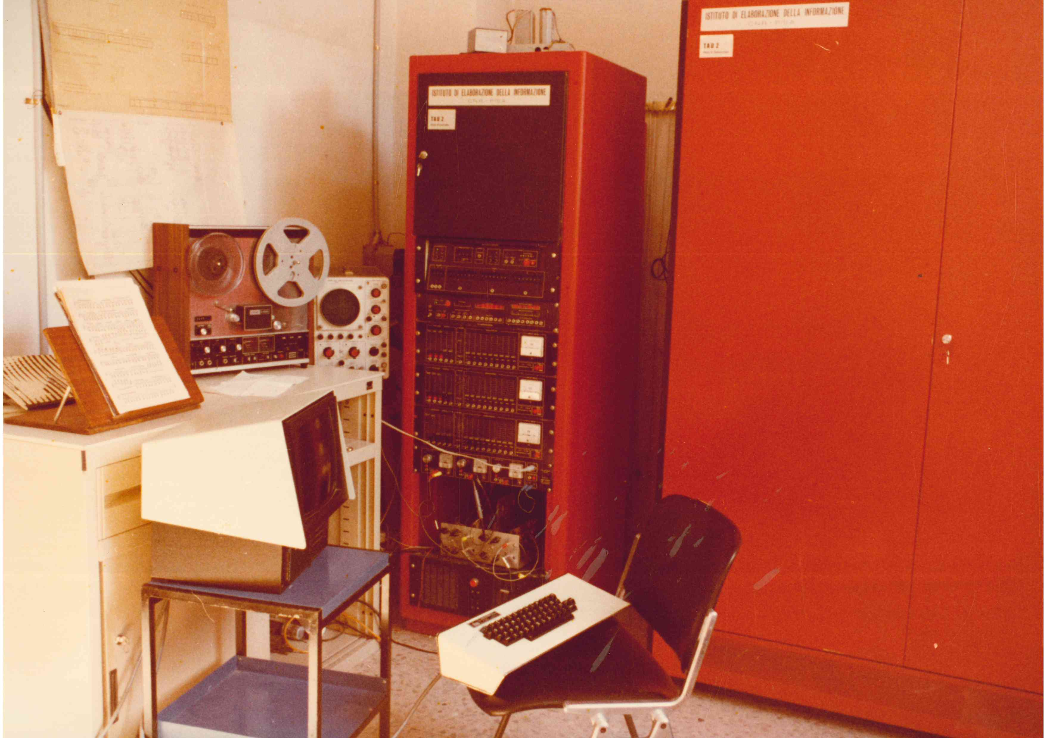
TAUmus : why is it so interesting?
Developed in Pisa: fits well the SWHAP@Pisa project
Dedicated (and still existing) hardware
A pioneeristic work
Tons of related material (thanks to Leonello Tarabella)

Slide 7
An overview of Grossi's work
Born in 1917 in Venice
1965: professor for the first electronic music course in Italy
1967: starts exploring computer music (first Olivetti, then CNUCE)
1970: first experiment on musical telematics
1975: deployment of TAU2/TAUmus system
1985: introduces the concept of Home Art

Slide 8
An overview of Grossi's work
Born in 1917 in Venice
1965: professor for the first electronic music course in Italy
1967: starts exploring computer music (first Olivetti, then CNUCE)
1970: first experiment on musical telematics
1975: deployment of TAU2/TAUmus system
1985: introduces the concept of Home Art
More info: https://www.pietrogrossi.org

Slide 9
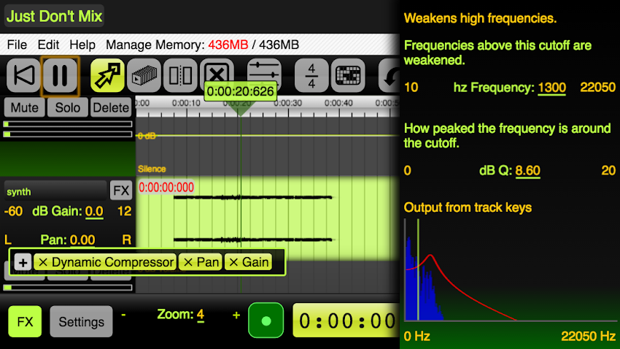
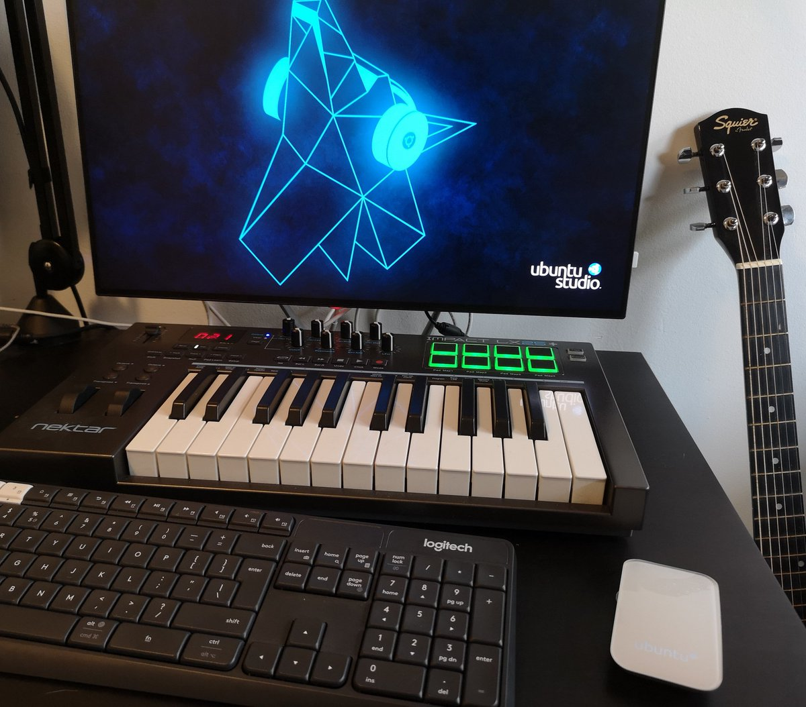
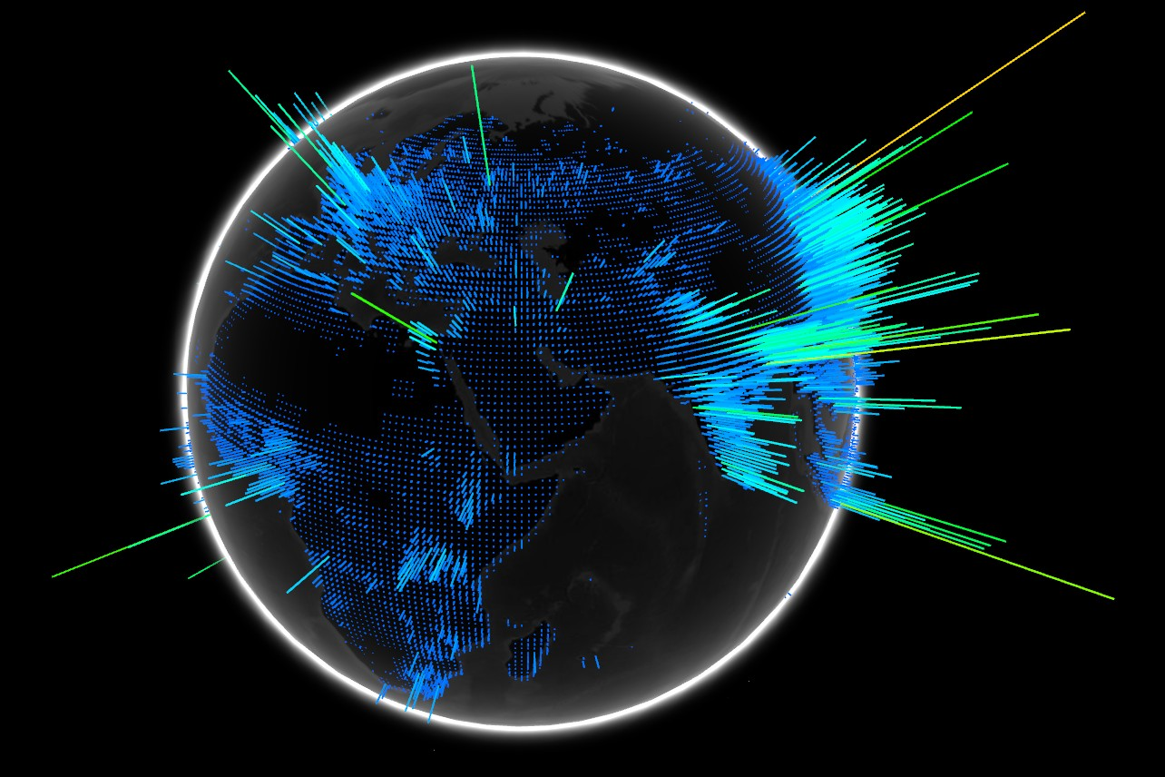
Home art nowadays

Slide 10
Tarabella's fonds of TAUmus
Three main categories:

Slide 11
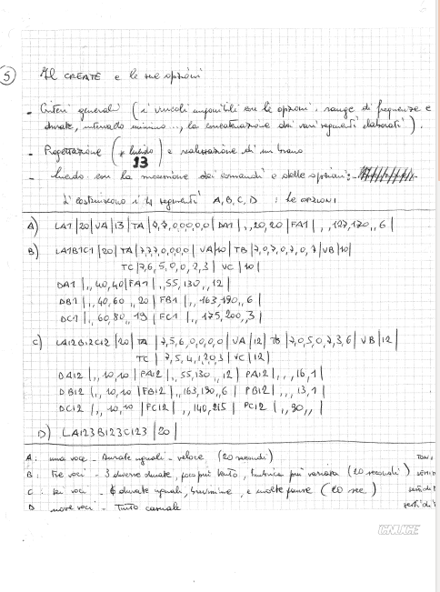
Tarabella's fonds of TAUmus
Three main categories:
Papers and sketches

Slide 12
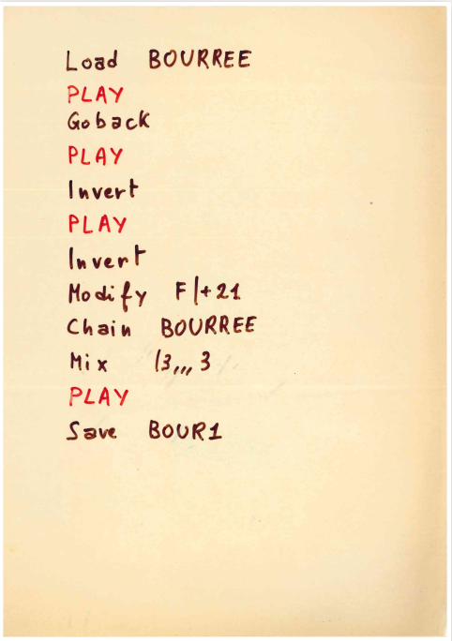
Tarabella's fonds of TAUmus
Three main categories:
Papers and sketches
Source code

Slide 13
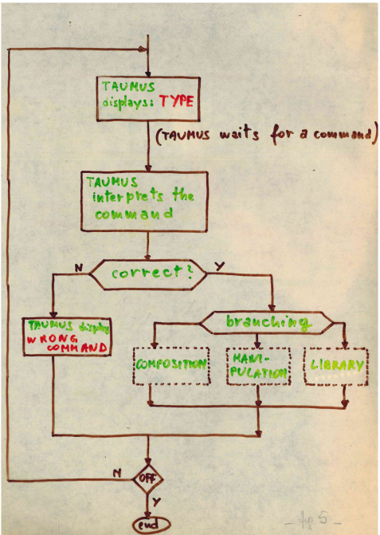
Tarabella's fonds of TAUmus
Three main categories:
Papers and sketches
Source code
Project specifications

Slide 14
Different kinds of Source Code

Slide 15
Different kinds of Source Code
FORTRAN listings:
TAU2 was just an audio terminal: it didn't run code
Code ran on the CNUCE's IBM 370
These are (part of) the code of the TAUmus interpreter

Slide 16
Different kinds of Source Code
FORTRAN listings:
TAU2 was just an audio terminal: it didn't run code
Code ran on the CNUCE's IBM 370
These are (part of) the code of the TAUmus interpreter
TAUmus listings:
Hand-written, the actual code of music sessions
The interpreter was basically a terminal
The user could play music using the TAUmus commands

Slide 17
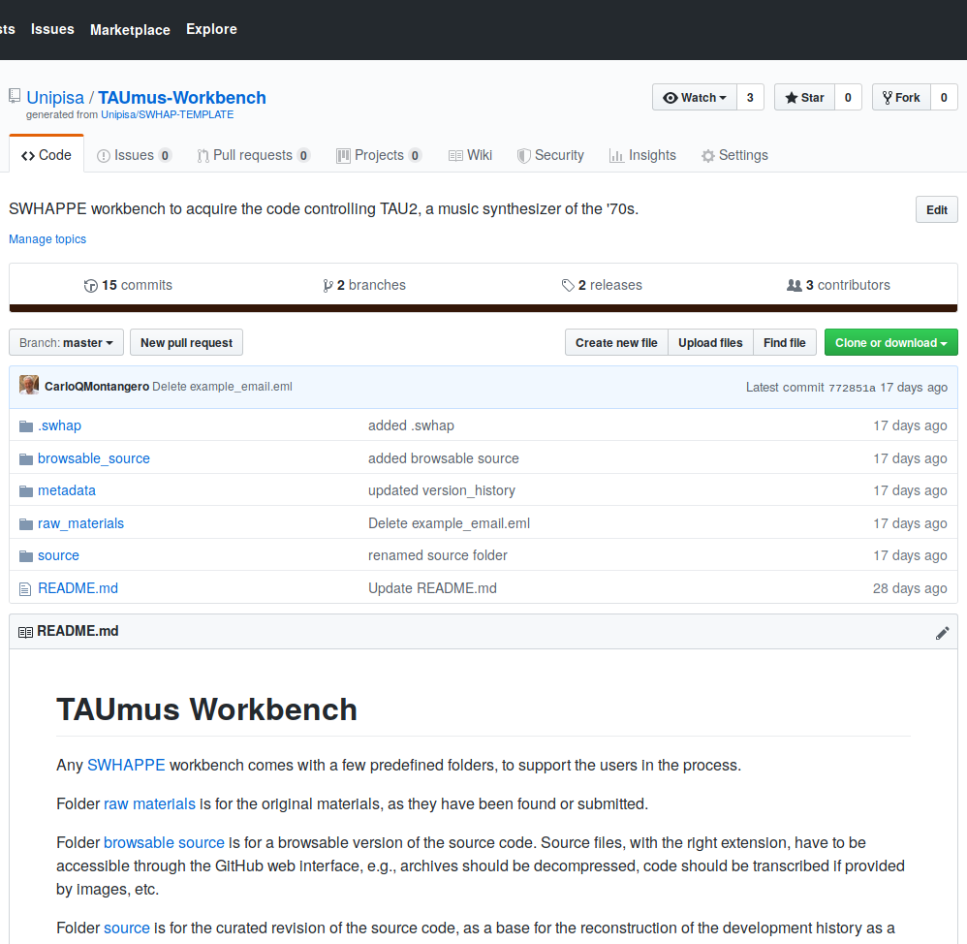
The process, instantiated
TAUmus Workbench is the (virtual) place where the work actually started

Slide 18
The process, instantiated
TAUmus Workbench is the (virtual) place where the work actually started
The directory structure is inherited from the SWHAP template

Slide 19
The process, instantiated
TAUmus Workbench is the (virtual) place where the work actually started
The directory structure is inherited from the SWHAP template
From here, we performed the process's steps

Slide 20
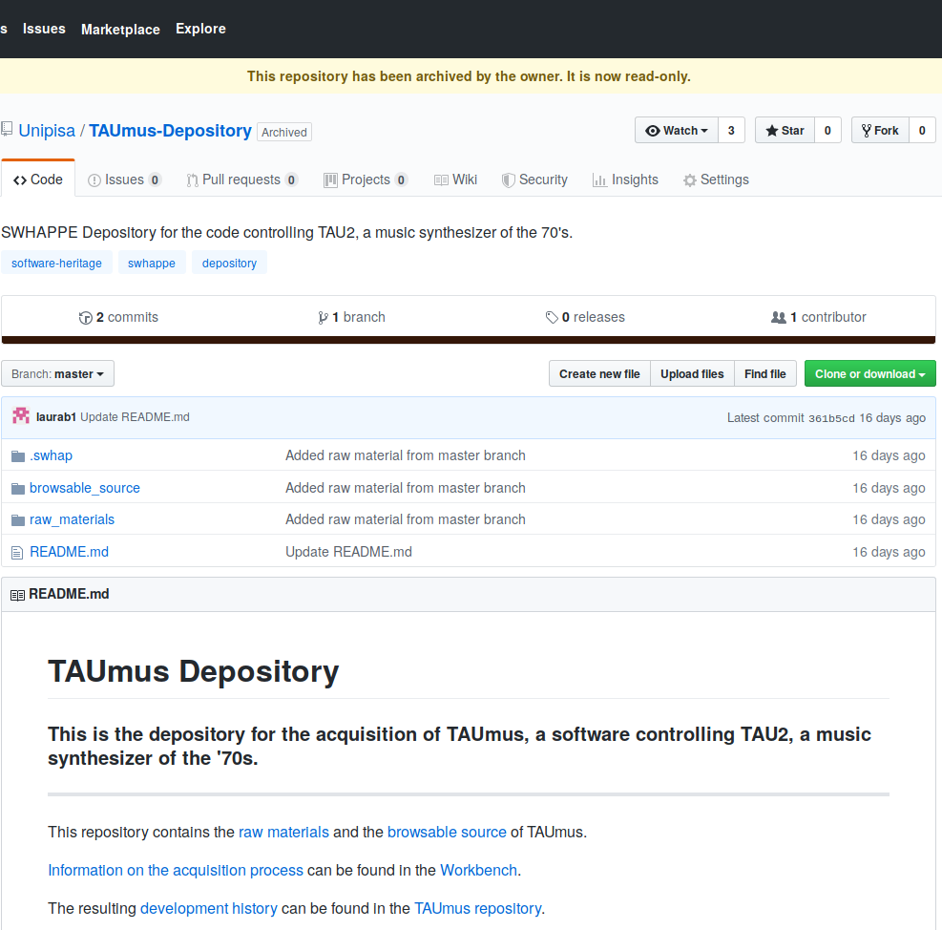
The process, instantiated
First we created the Depository

Slide 21
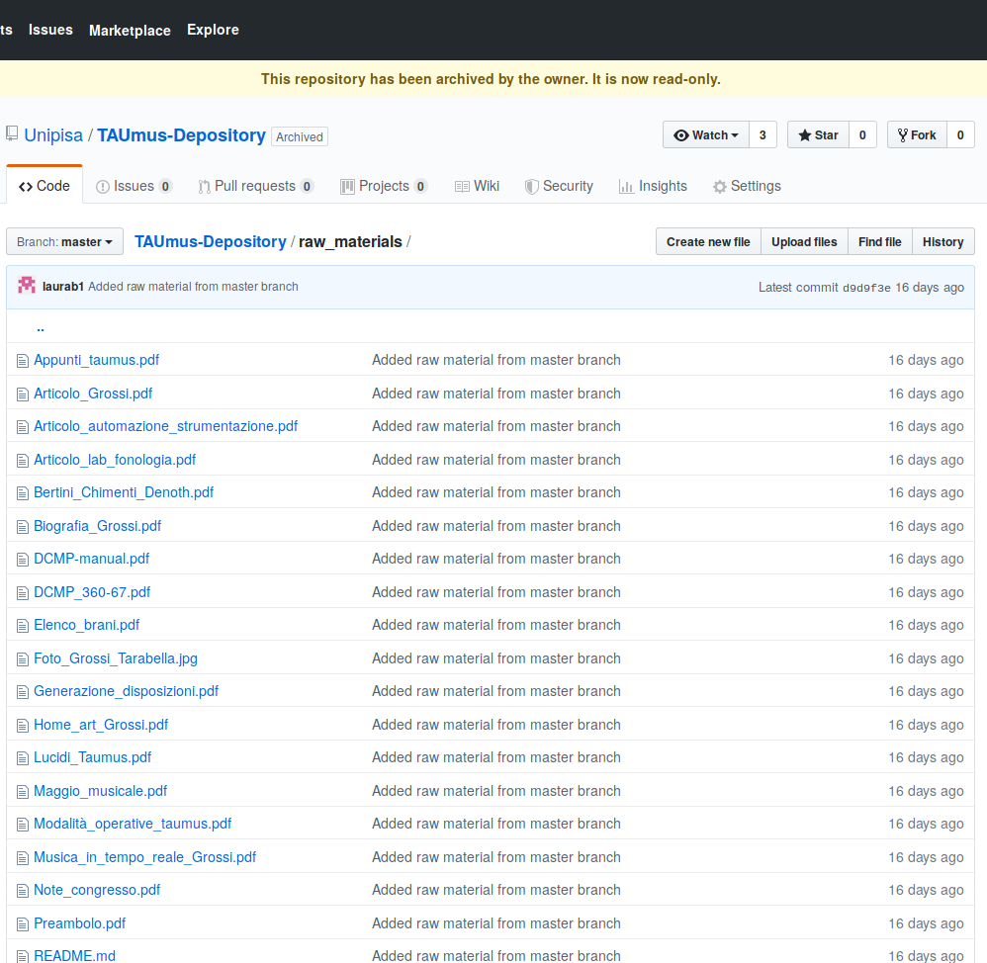
The process, instantiated
First we created the Depository
Here we have raw-material...

Slide 22
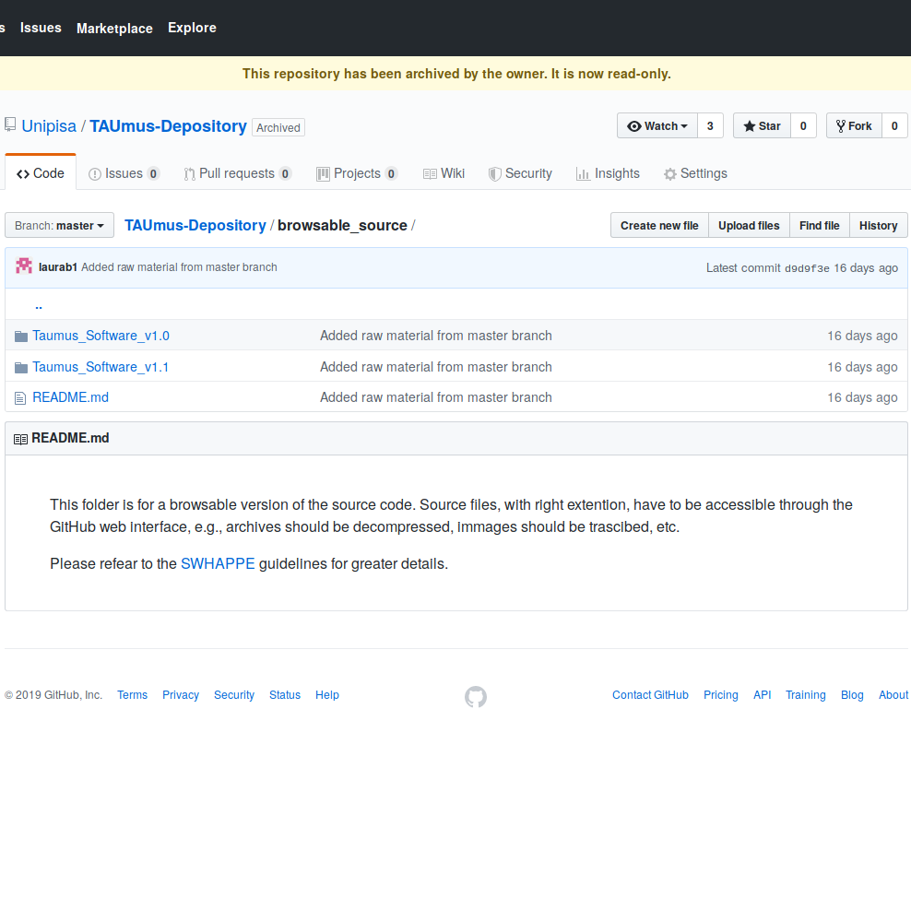
The process, instantiated
First we created the Depository
Here we have raw-material...
...and browsable-source

Slide 23
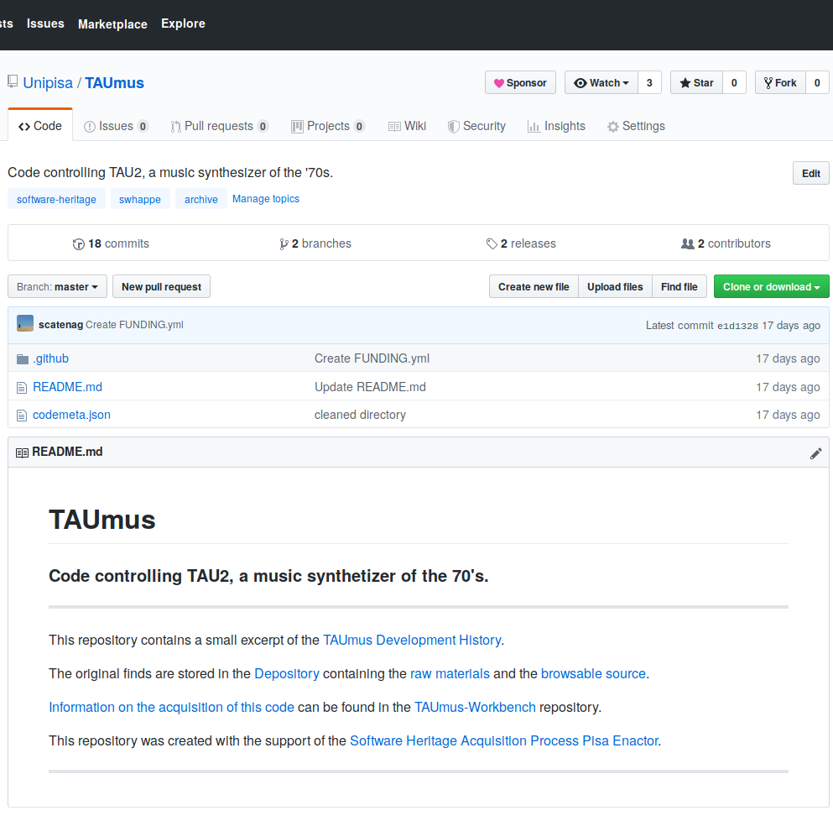
The process, instantiated
First we created the Depository
Here we have raw-material...
...and browsable-source
Then we (re)created the development history

Slide 24
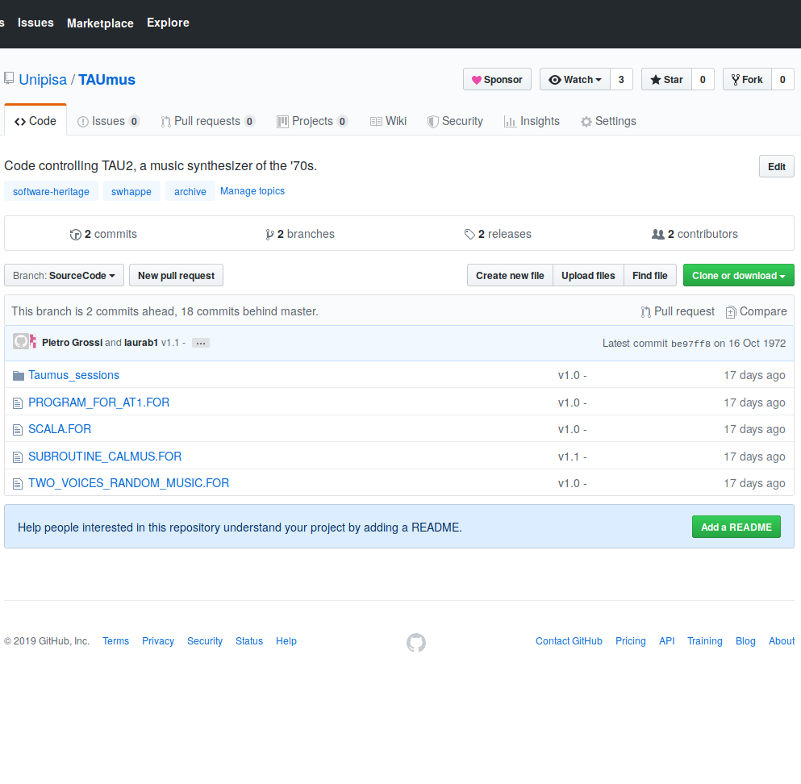
The process, instantiated
First we created the Depository
Here we have raw-material...
...and browsable-source
Then we (re)created the development history
The SourceCode branch contains the versioned code

Slide 25
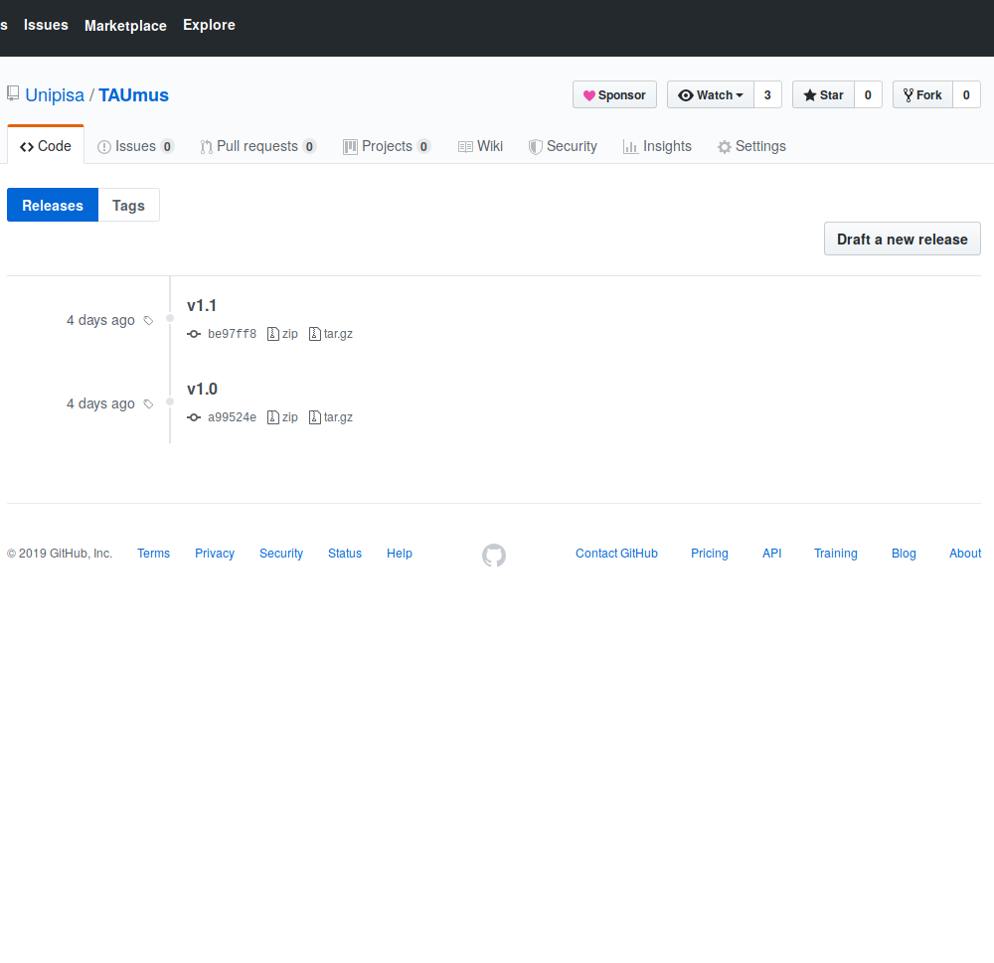
The process, instantiated
First we created the Depository
Here we have raw-material...
...and browsable-source
Then we (re)created the development history
The SourceCode branch contains the versioned code
The development history can be seen by checking for releases

Slide 26
TAUmus lives back!

Slide 27
TAUmus lives back!

Slide 28
What we achieved
An important piece of software has been recovered
A working sample of the music produced using TAUmus software is now available for everybody
TAUmus authors and contributors work is recognized and preserved on GitHub and the Software Heritage archive
Present phase of the process has been partially implemented

Slide 29
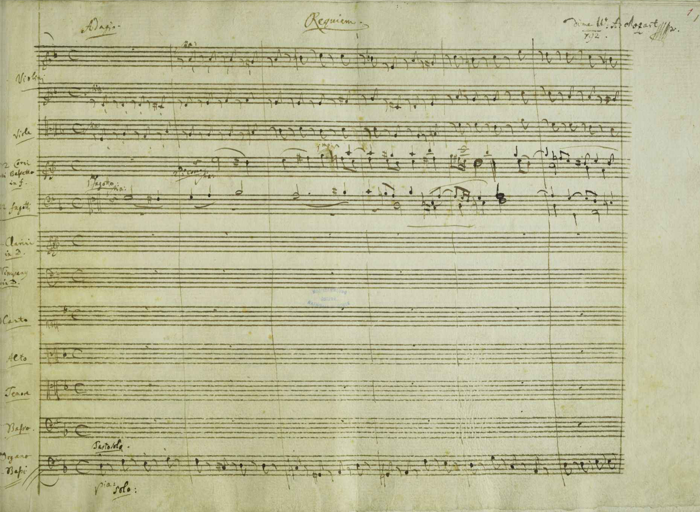
What's next
TAUmus provides an important starting point for further discussions
What about "holes"?
Does it make sense to deploy a full functioning TAUmus clone on a modern computer?
Isn't source code like music, in the end?

Slide 30
Thank you!

