Slide 1
ENEA and the first Software Heritage Mirror
“ software source code is a unique form of knowledge which is designed to be understood by a human being, the developer, and at the same time is easily converted into machine executable form”
[R.Di Cosmo, S.Zacchiroli, iPRES 2017: 14th Inter. Conf. on Digital Preservation, Kyoto]
Annual symposium & summit on Software Heritage 2023
UNESCO Headquarters, Paris
Giovanni Ponti / ENEA-TERIN-ICT / February 7th 2023

Slide 2



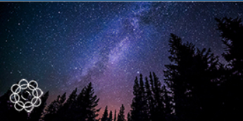
ENEA infrastructures and main projects
ENEA National Agency for New Technologies, Energy and Sustainable Economic Development
ENVIRONMENT and SUSTAINABILITY
ENERGY TECHNOLOGY
ENERGY EFFICIENCY
FUSION and NUCLEAR SAFETY
The ENEA Software Heritage mirror– February 7th - UNESCO Headquarters, Paris

Slide 3
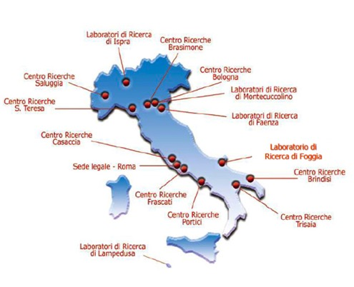
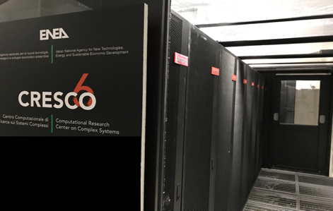
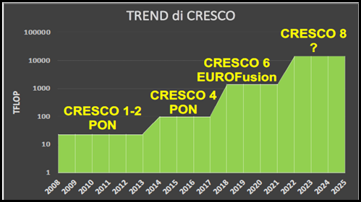
ENEA - since 1960 a long tradition in computational science and HPC infrastructures
CRESCO6 –
Italian Tier1 HPC
Cores 20832, Nodes 434
Peak performance 1.4 PF

Slide 4

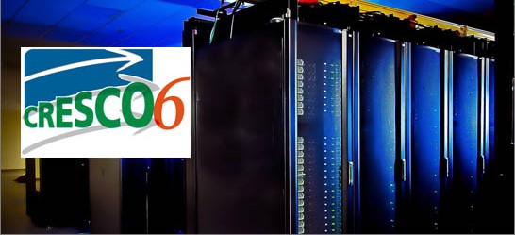
ENEA and the mirror of Software Heritage Archive
+
ENEA
since 1960
a long tradition in computational science and code development
=
INRIA - ENEA Cooperation Agreement
a great adventure has started

Slide 5
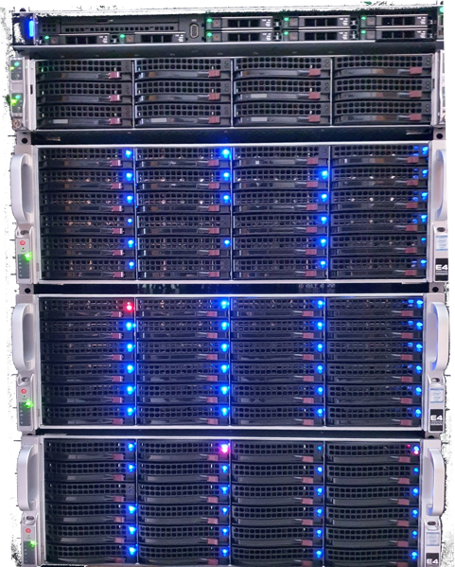
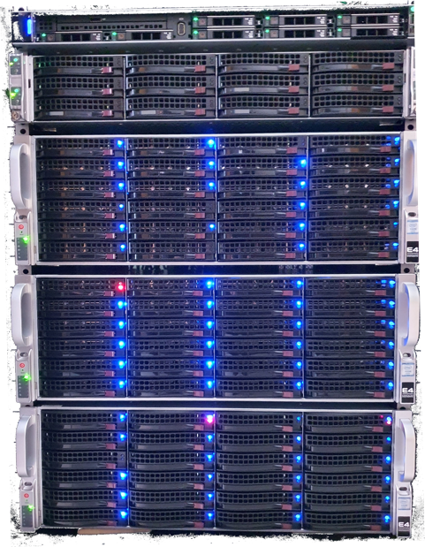
ENEA: the [experimental] mirror
A mirror for
improving project sustainability
reducing data loss risk
experimeting new solutions
based on 8 nodes
3 Dockers swarm nodes
1 DB server [34 TB]
4 storage servers [755 TB + 1PB Q1 ]
specific goal: testing SEAWEEDFS
highly scalable distributed file system
to store billions of files
to serve the files fast

Slide 6
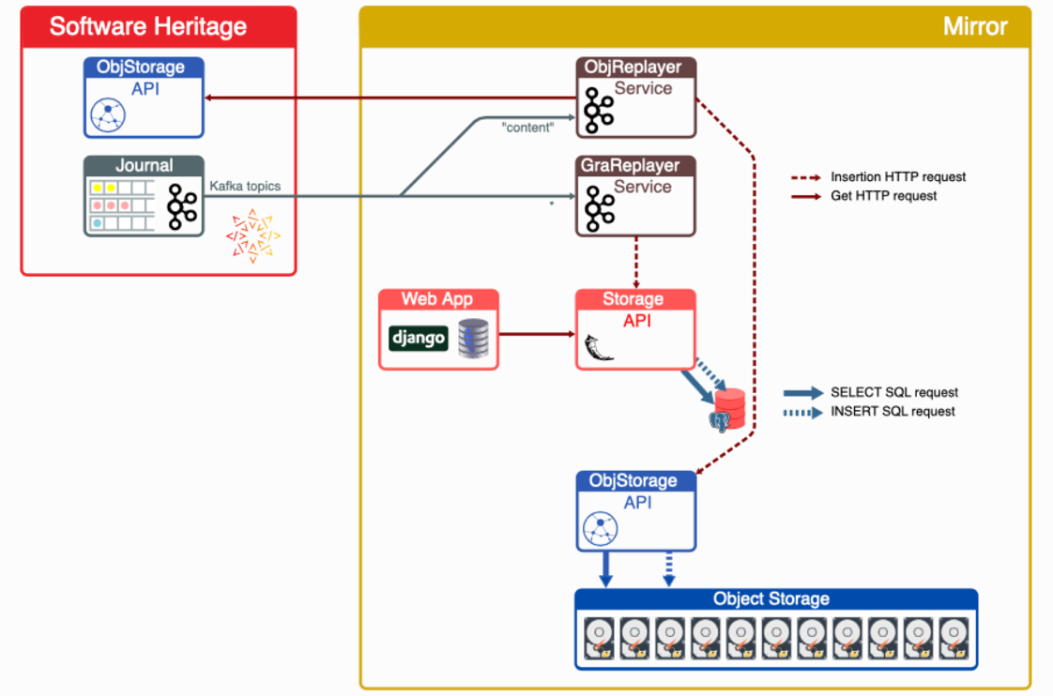
ENEA: the [experimental] mirror
SWH mirror components

Slide 7
ENEA: the [experimental] mirror
SWH ENEA Mirror Architecture

Slide 8
ENEA: the [experimental] mirror
SWH ENEA Mirror Architecture

Slide 9
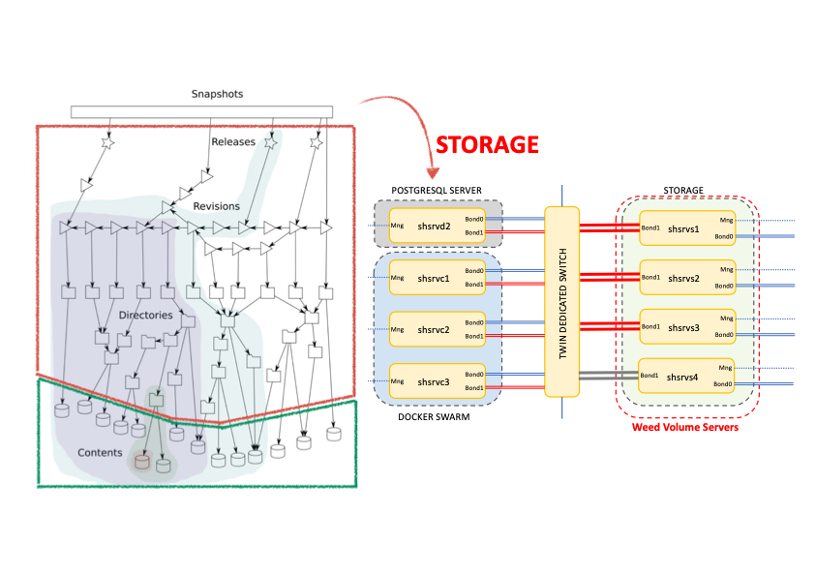
ENEA: the [experimental] mirror
SWH ENEA Mirror Architecture
MERKLE DIRECT ACYCLIC GRAPH

Slide 10
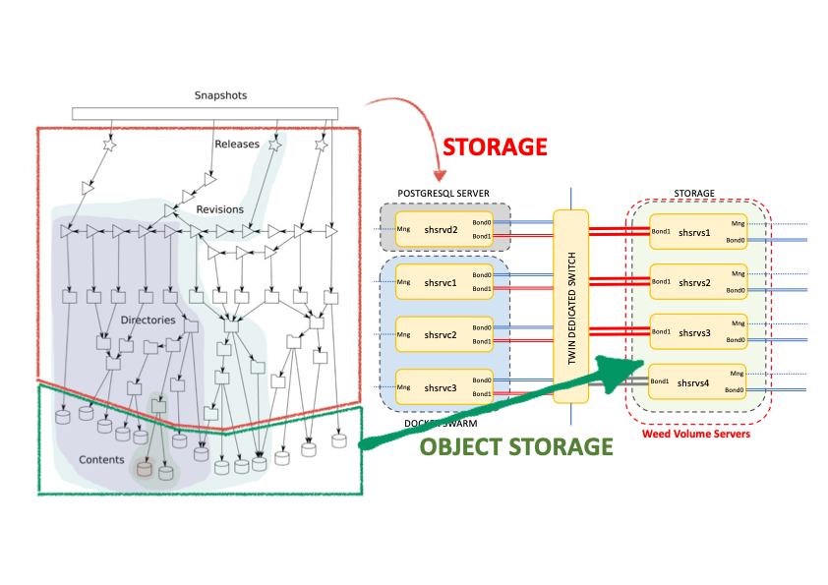

ENEA: the [experimental] mirror
SWH ENEA Mirror Architecture
MERKLE DIRECT ACYCLIC GRAPH

Slide 11
ENEA: the [experimental] mirror
SWH ENEA Mirror Architecture
MERKLE DIRECT ACYCLIC GRAPH
TRANSFER COMPLETE
TRANSFER IN PROGRESS
THE MIRROR WILL BE IN PRODUCTION ON JUNE 2023

Slide 12
ENEA & SH: the mirror as a research infrastructure
The Software Heritage’s mirror as a starting point for
research collaboration to:
experiment the application of Machine Learning and AI for software development and programming languages practice
➔ Big code as Big data
develop new solutions for Big Archival Storage
tackling the problem of “resilient digital heritage” against catastrophic loss of data and obsolescence of archiving tools
involve young researchers in a relatively new field of investigation (Big Code/Big Data/BigStorage)

Slide 13
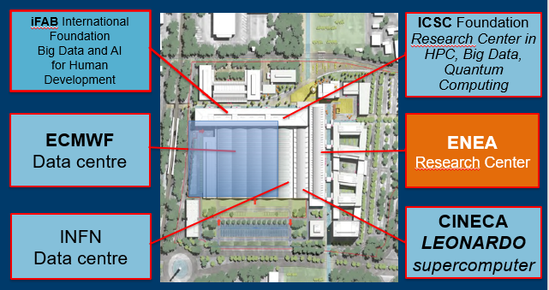
ENEA’s SH mirror
within the Big Data Technopole in Bologna
an area of 100.000 m2 - 1 billion € of investments for HPC - BigData - AI - QC

Slide 14
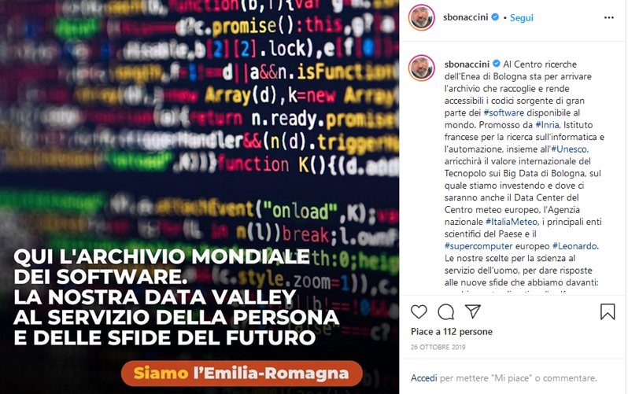
Emilia Romagna Region and the SH Mirror
The warmly welcome of Stefano Bonaccini
the President of the Emilia Romagna Region to the Software Heritage's Mirror, entrusted to a post on Twitter.
“Here is the world software archive.
Our data valley to serve people and to facing future challenges”

Slide 15
Giovanni Ponti
giovanni.ponti@enea.it

