Slide 1


Large-scale compression of software source code
A. Boffa, P. Ferragina
(joint also with A. Guerra, G. Manzini, G. Vinciguerra)
A³ lab: Advanced Algorithms and Applications
Dipartimento di Informatica

Slide 2
Why data compression?
It provides rich dividends:
Space saving, of course!
  … and thus, reduced storage and transmission costs
Energy saving: less servers involved
Speed: not so obvious!
  better exploitation of the memory hierarchy
  reduced burning out of sectors in SSD disks
  no need to decompress the whole data, in some approaches

Slide 3

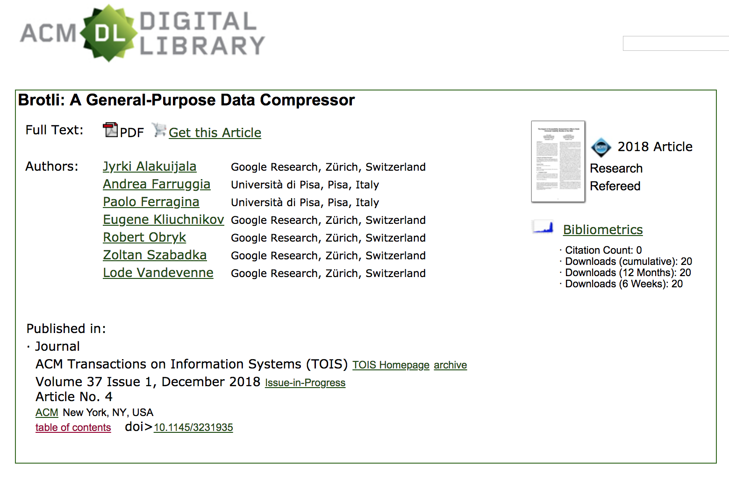

The edition of 2016

Slide 4
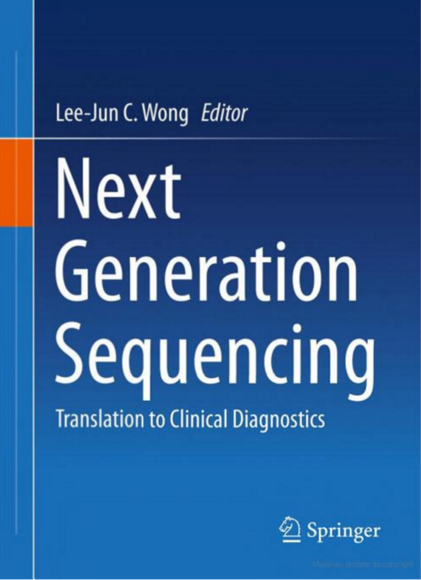

Searching Compressed Data
FM-index
We were the first in 2000 to show how to search compressed data, without decompressing all of them
BWA
BowTie

Slide 5
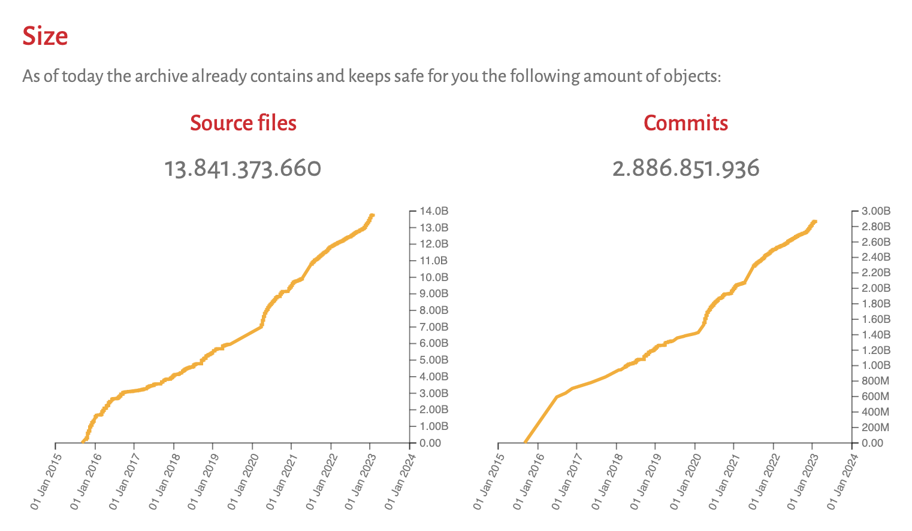
The Software Heritage...
Raw space (files) is about 1 PetaByte (10¹⁵ bytes)

Slide 6
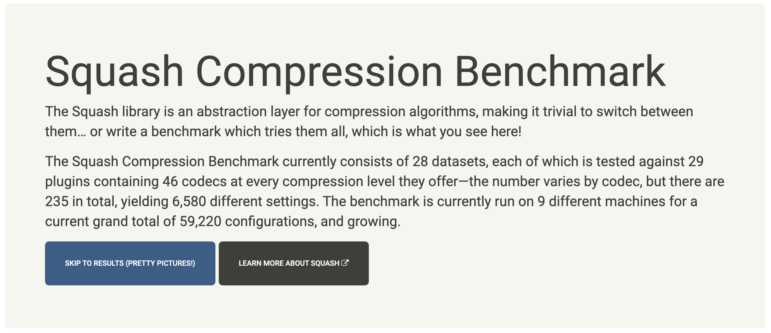
How to approach the problem?

Slide 7
Three main families of compressors
[1977] Lempel-Ziv parsing and its derivatives
  The classic approach, made famous by gzip
  A revamped interest around it: 7z, zstd, brotli, lzfse, …
[1994] Burrows-Wheeler Transform and its derivatives
  Better entropy-bounds than gzip-like compressors (→ bzip)
  But building a big BWT is costly and complicated…
[2000] Compressed (self-)indexes: offer space/decompress trade-offs
  FM-index, CSA, LZ-trie,… [Ferragina-Manzini, J.ACM ‘05]
    In the compressed space, they include text + (full-text) index
    Query/Decompression time is theoretically optimal
New compressors are based on
sophisticated ML models, but slow.

Slide 8
Something to be careful…
We are talking about compressing a:
collection of files of different types.
We have to apply a different compression scheme:
PPC: Permute + Partition + Compress
and study it in two experimental scenarios
  BackUp for the streaming access to compressed data
  Random access to single compressed files
Two main issues to deal with:
Permuting based on which information ? filename, path, file type, content,…
Partitioning based on which block size ? BackUp/Random access, compressor,..

Slide 9









Our experimental framework
The C and Python repositories in Github with most stars,
each consisting of about 25 Gb.
Brotli
ZStandard

Slide 10
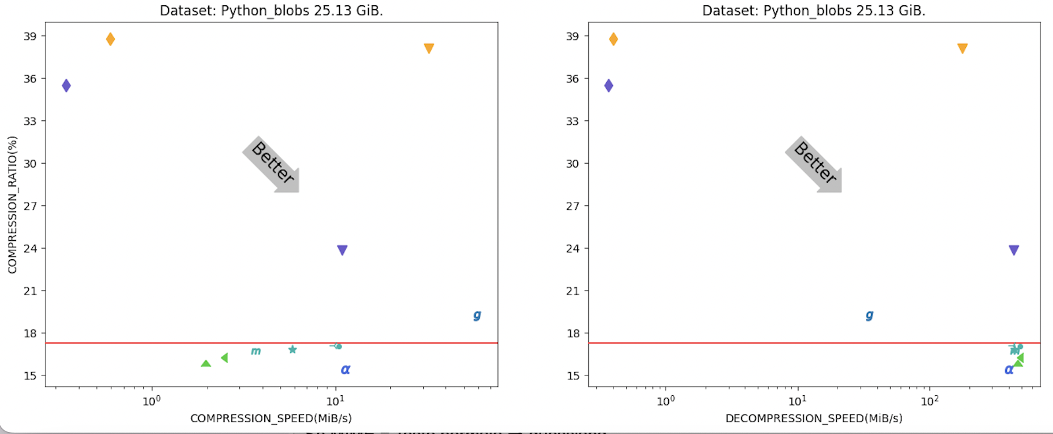
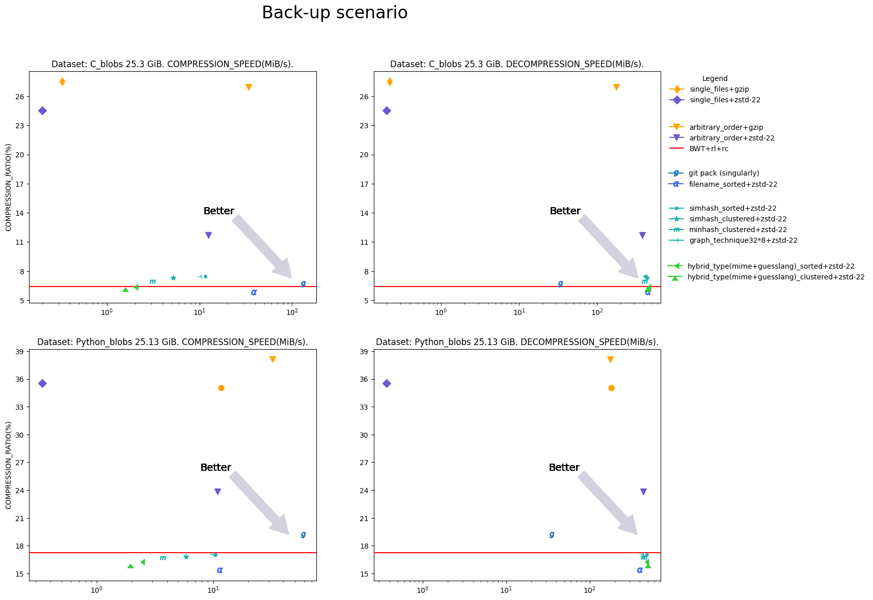
BackUp scenario: Python files ≅ 25Gb
For random access, even with 4 MB blocks, HYBRID is very robust by loosing only about 1% in compression ratio wrt Backup scenario
150
450
On C files we get about 6% vs 27% compr. ratio of gzip
simhash_graph+zstd-22
Notes:
Se MIME = Testo normale → guesslang
Punti arancioni:
Soluzione attuale: single_files+gzip
Visto che vogliamo fare back-up, comprimiamo tutti i file concatenati ancora con gzip, migliorando di poco il compression ratio e velocizzandoci moltissimo.
Punti viola:
Ci accorgiamo che ci sono compressori di nuova generazione tipo zstd -22.
BWT: l’ordine con cui si comprimono i file conta molto, e vogliamo arrivare alla linea rossa, classicamente considerata il limite inferiore della compressione (ad oggi se ne sta discutento dato che per i testi molto ripetitivi si può fare di meglio, infatti lo vediamo in questo plot)
Punti blu:
Soluzioni in letteratura che però hanno bisogno di molte informazioni sui file non sempre disponibili (storia, filename, etc…)
Infine punti arruzzi:
nostre soluzioni data-aware, ingegnerizzate per questo problema che non hanno bisogno di nessuna informazione sui file, raggiungono il miglior compression ratio

Slide 11
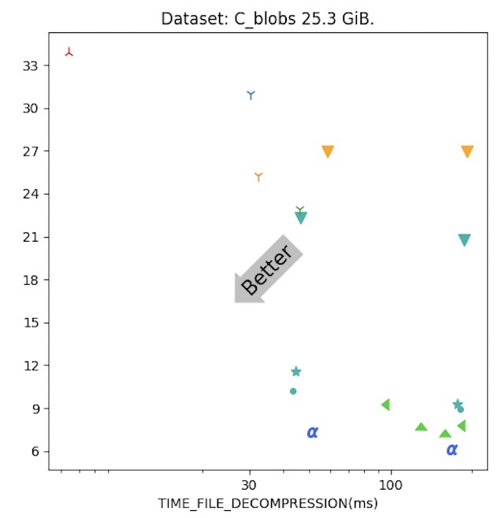
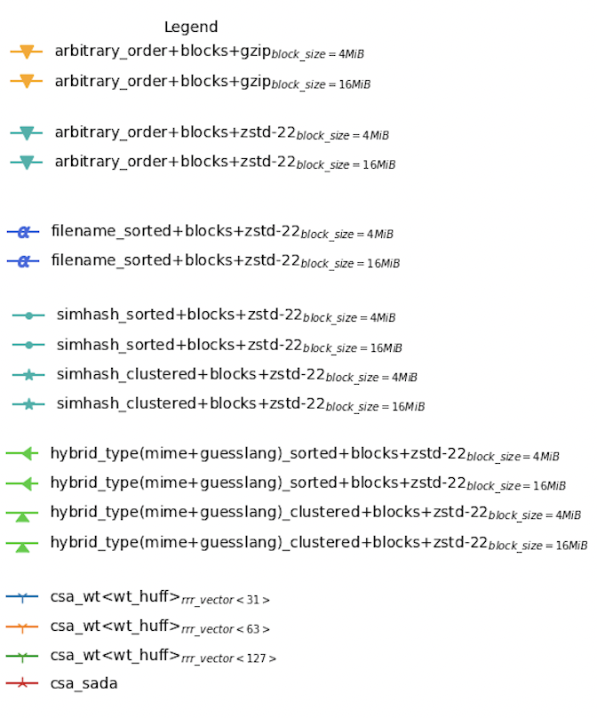
Random access: C files ≅ 25Gb
The difference on Python between hybrid and filename_sorted is negligible
Use blocks of 4-16 MBs
The compression loss is about 10%
The compression loss is about 3%
The compression loss is about 1%
Notes:
Per le soluzioni che comprimono a blocchi (quindi tutte tranne i csa) considero il tempo per decomprimere un intero blocco da 4/16MiB.

Slide 12
The moral...
We compared Data-aware-PPC versus Context-aware approaches (à la GitPack), achieving the following results:
  Our features subsume the "context" at a larger decompression speed than GitPack
  They are robust with respect to block size
  zstd is a good compressor: large window at 100MB/sec speed
Next, we aim at:
  Investigating other orderings and partitionings
  C++ coding & HPC is needed because a single machine would take about 3 months of computation (≅ 200 Tb space at about 4k euro).
It’s time to try it on the whole SH

