Slide 1

UNESCO Recommendation on Open Science
Dr Peggy Oti-Boateng, Director Division Science Policy and Capacity Building, UNESCO

Slide 2
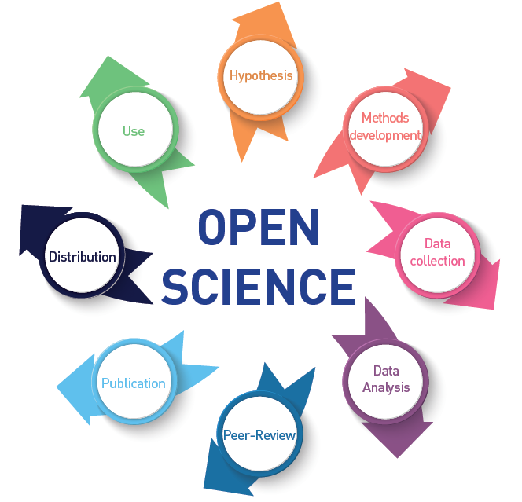
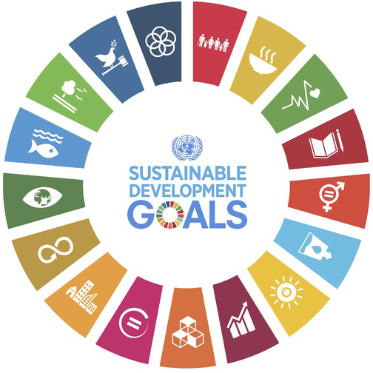

Why Open Science in UNESCO?
Open Science has the potential of making the scientific process more transparent, inclusive and democratic.
Open Science is increasingly recognized as a critical SDGs accelerator.
Open Science can be a true game changer in bridging the science, technology and innovation gaps between and within countries and fulfilling the human right to science.

Slide 3
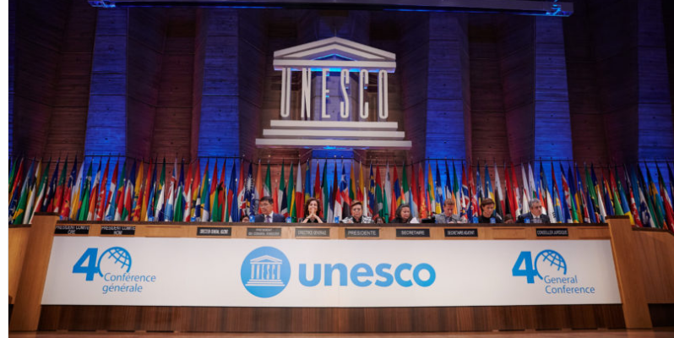
Open Science in UNESCO
In 2019 the General Conference at its 40th session:
Recognized the need for a new standard-setting instrument on open science, in the form of a recommendation;
Invited the Director-General to initiate the process of elaborating a draft text of a new standard-setting instrument on open science, in the form of a recommendation;
Also requested the Director-General to take all necessary measures to ensure an inclusive consultative process leading to a recommendation on open science;
Further invites the Director-General to submit to it at the earliest possible session (preferably the 41st session) the draft text of a UNESCO recommendation on open science

Slide 4
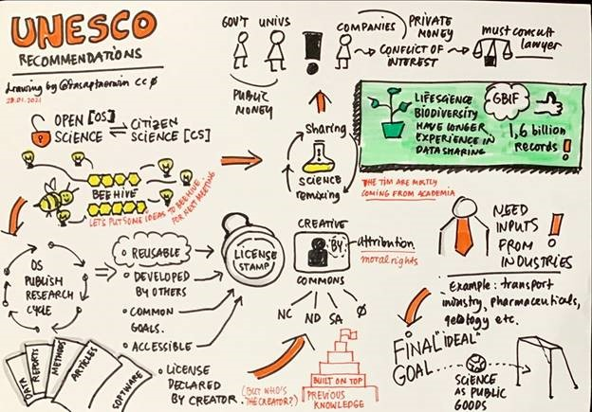
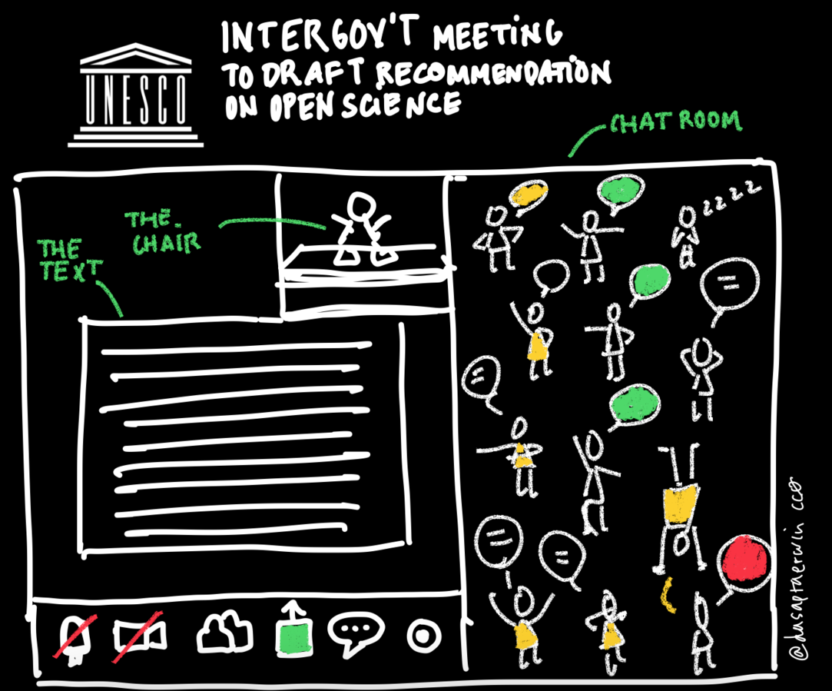
Towards a UNESCO Recommendation on Open Science
    The process towards the Recommendation
    Consultative, inclusive, transparent and multi-stakeholder
    guided by an international Open Science Advisory Committee
    supported by a global Open Science Partnership
Global multistakeholder consultation – online survey
2900 inputs received from 133 countries
Regional consultations
Africa, Arab States, Western Europe $ North America,
Eastern Europe, Asia & Pacific, Latin America & the Caribbean
Thematic/stakeholder consultations and inputs
Young scientists, Citizen science, Academies, Science unions and organizations, Libraries and open access platforms, Data organizations, UN system, Indigenous peoples
Intergovernmental negotiations
Legal and technical experts from over 100 countries negotiate and adopt the draft text in May 2021

Slide 5

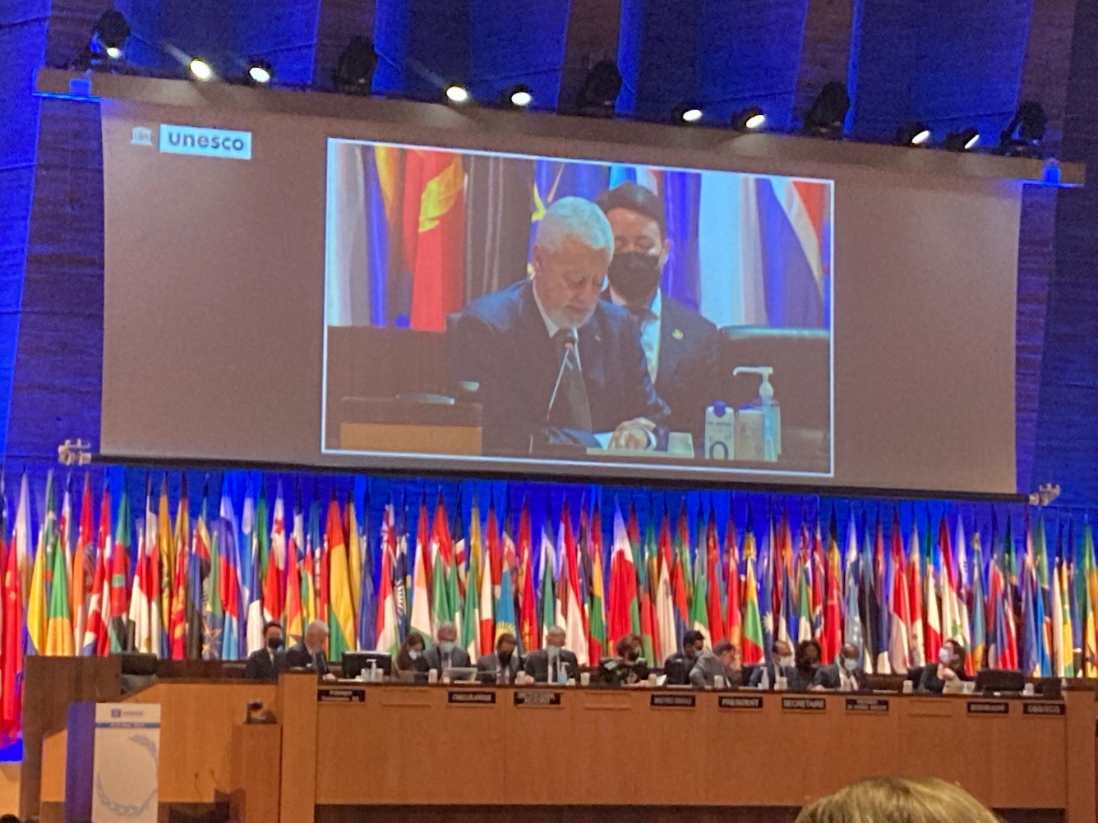
Towards a UNESCO Recommendation on Open Science
Adoption by 193 countries at the UNESCO General Conference on 23 November 2021

Slide 6
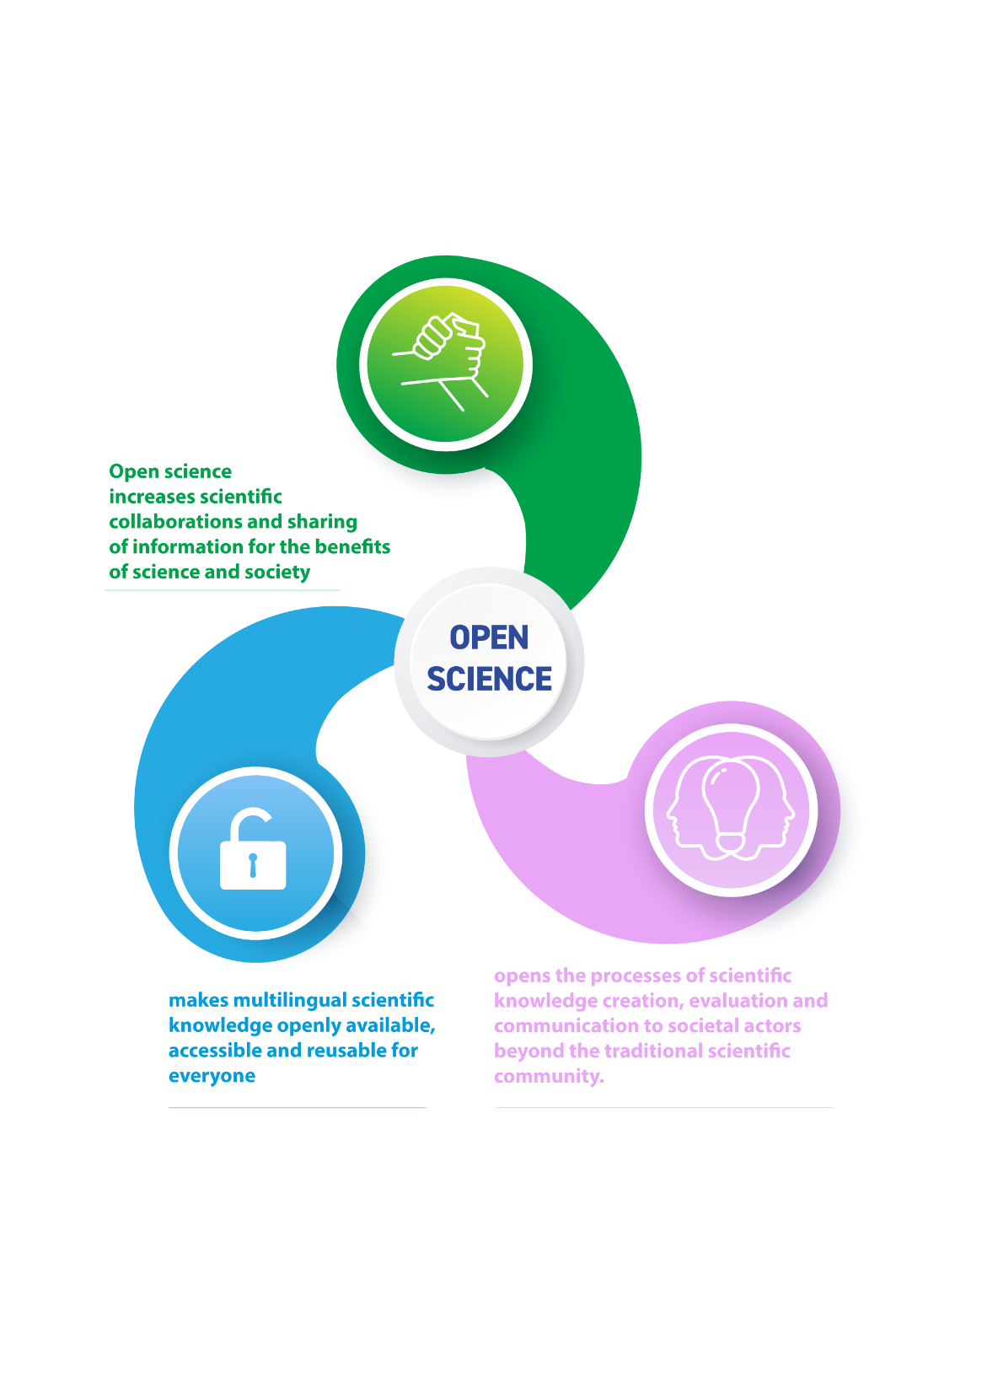
Draft text of the Recommendation
The Recommendation outlines a common definition, a set of shared values and principles and a set of actions conducive to a fair and equitable operationalization of open science for all.
6. Open science is defined as an inclusive construct that combines various movements and practices aiming to make multilingual scientific knowledge openly available, accessible and reusable for everyone, to increase scientific collaborations and sharing of information for the benefits of science and society, and to open the processes of scientific knowledge creation, evaluation and communication to societal actors beyond the traditional scientific community.

Slide 7
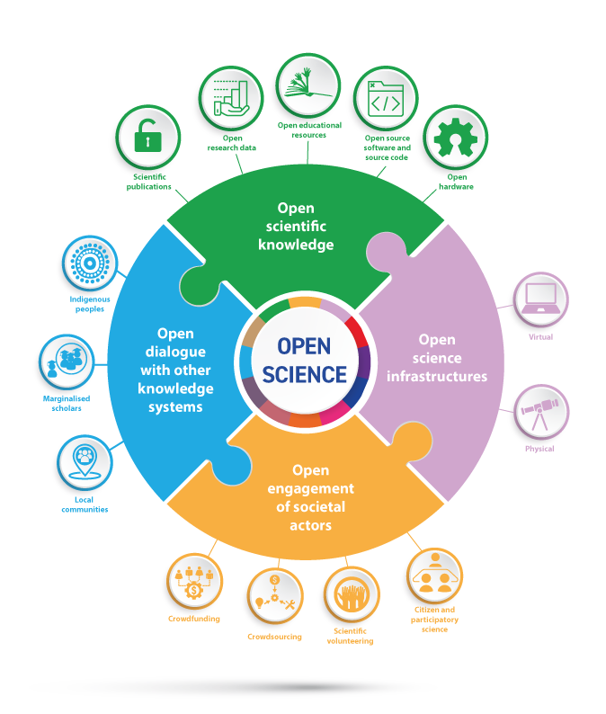
Key Pillars of Open Science

Slide 8
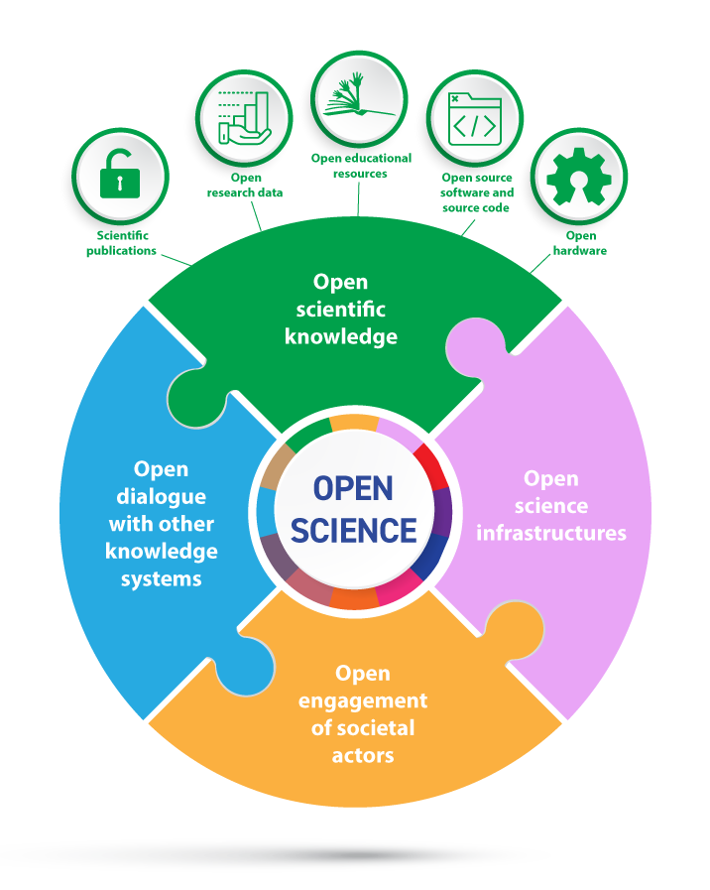
Open scientific knowledge
7. Open scientific knowledge refers to open access to scientific publications, research data, metadata, open educational resources, software, and source code and hardware that are available in the public domain or under copyright and licensed under an open license that allows access, reuse, repurpose, adaptation and distribution under specific conditions, provided to all actors immediately or as quickly as possible ….. and free of charge.
8. Access to scientific knowledge should be as open as possible. Access restrictions need to be proportionate and justified.

Slide 9

Open source software and source code
7.d) Open source software and source code that generally include software whose source code is made publicly available, in a timely and user-friendly manner, in human- and machine-readable and modiﬁable format, under an open license that grants others the right to use, access, modify, expand, study, create derivative works and share the software and its source code, design or blueprint.
The source code must be included in the software release and made available on openly accessible repositories and the chosen license must allow modiﬁcations, derivative works and sharing under equal or compatible open terms and conditions.
In the context of open science, when open source code is a component of a research process, enabling reuse and replication generally requires that it be accompanied with open data and open specifications of the environment required to compile and run it.

Slide 10
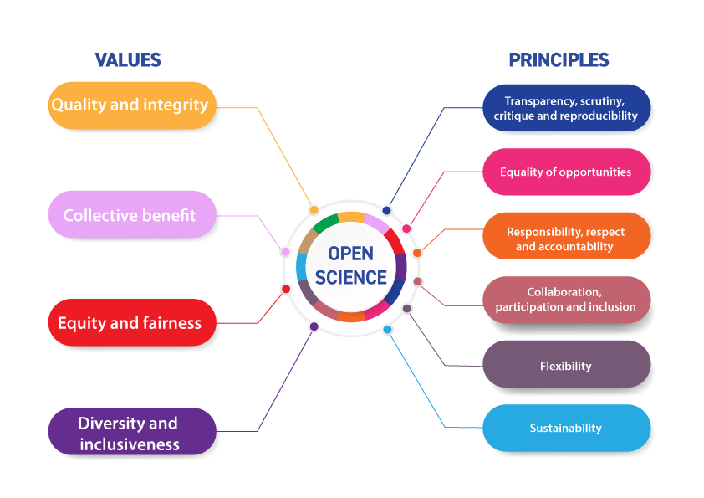
Values and Principles

Slide 11
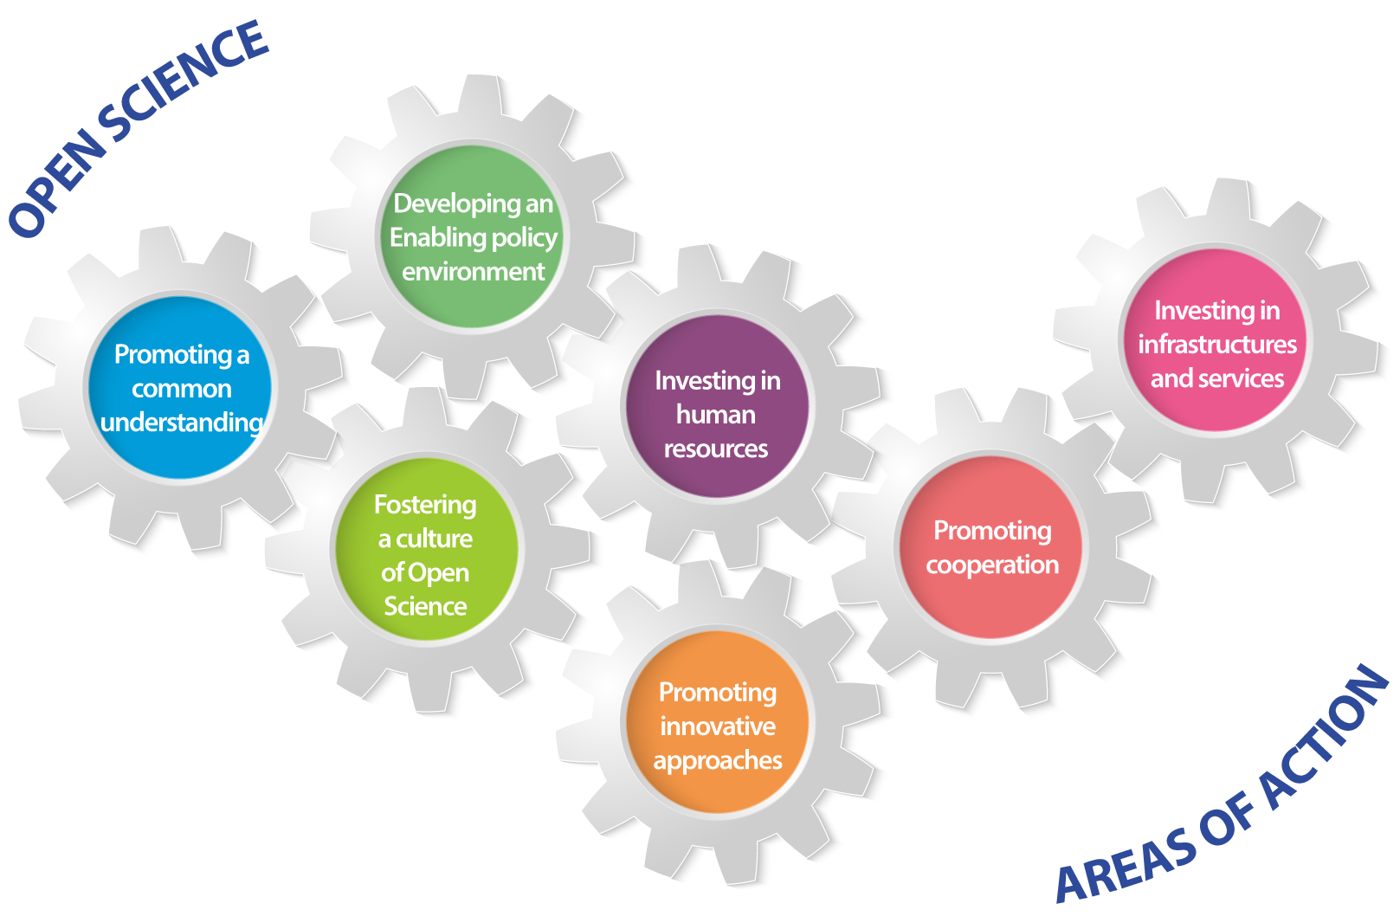
Areas of Action

Slide 12
Key Challenges
Change in the conventional scientific culture;
Capacity building;
Investment in adequate infrastructures, including reliable internet connectivity;
Alignment of incentives and revision of criteria for evaluation of scientific excellence and scientific careers, particularly for young researches;
Addressing the unintended negative consequences of open science practices, such as predatory behaviors, data migration, exploitation and privatization of research data, increased costs for scientists and high article processing charges;
Ensuring that open science incorporates the values and principles as outlined in this Recommendation to ensure that the benefits of open science are shared and reciprocal, and do not involve unfair and/or inequitable extraction of data and knowledge.

Slide 13


